Slide 1
Analytics for FAST Alumni Network
Basharat Hussain P176102@nu.edu.pk
Tahir Aziz
P176054@nu.edu.pk
Mehboob
P176046@nu.edu.pk
Supervisor
Mr. Muhammad Amin

Slide 2


Project Progress
Update scrapper
Data Preprocessed
Sources increasing for data set.
Updated Data Set
Data Mining
More Data Visualization
Applied Machine Learning (50%)
Prototype Analytics Dashboard

Slide 3
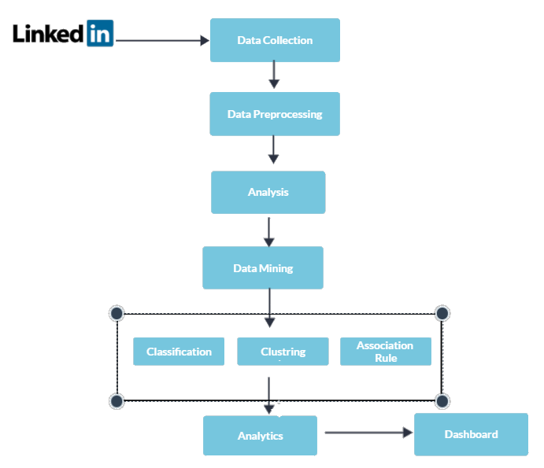
Plan Of Execution

Slide 4
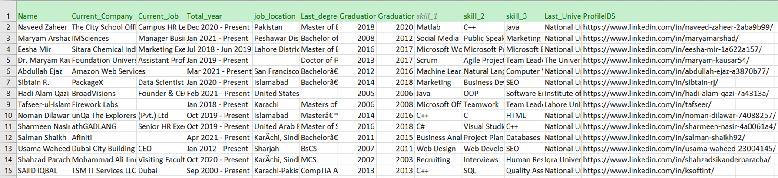
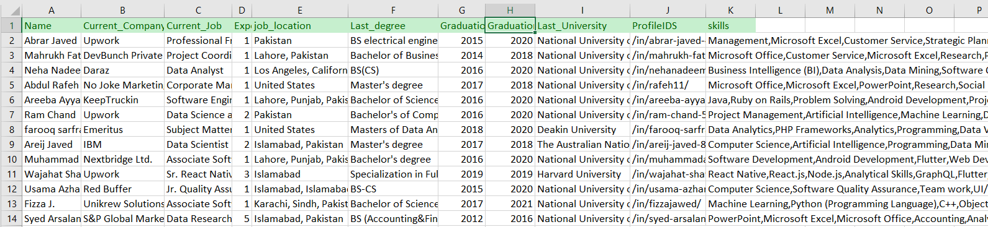
Data Set Updated

Slide 5
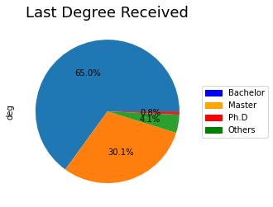
Last Degree of FAST Alumni

Slide 6
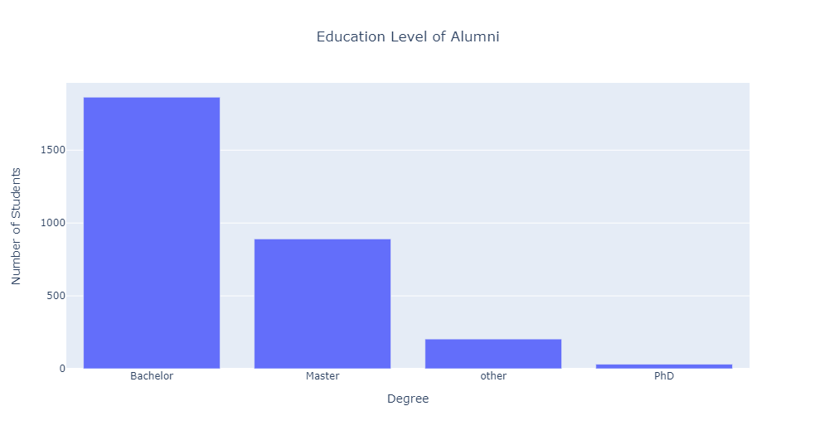
Last Degree of FAST Alumni

Slide 7
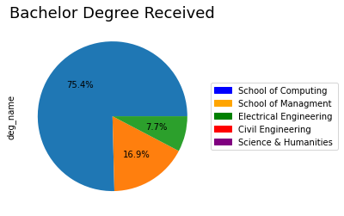
Bachelors Degree Field

Slide 8
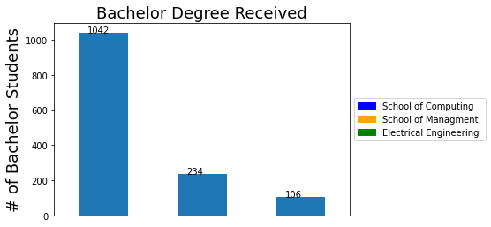
Types of Bachelor Degree of FAST Alumni

Slide 9
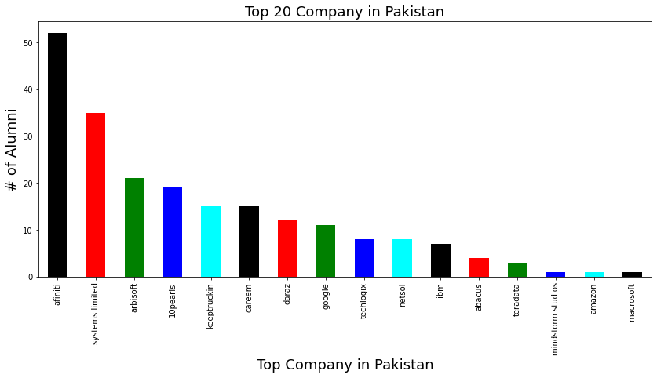
FAST Alumni in Top 20 Companies

Slide 10
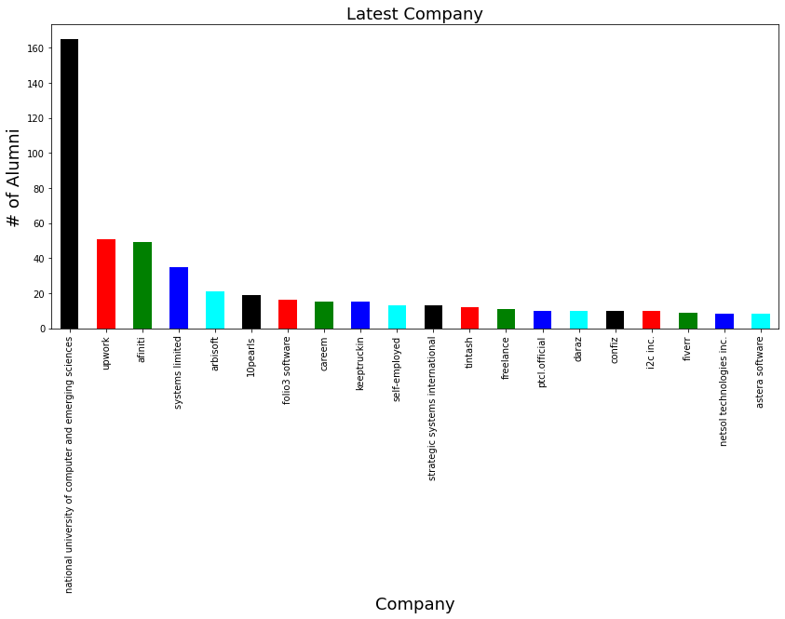
Latest Companies of FAST Alumni

Slide 11
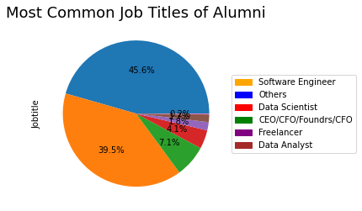
Most Common Job Titles of FAST Alumni

Slide 12
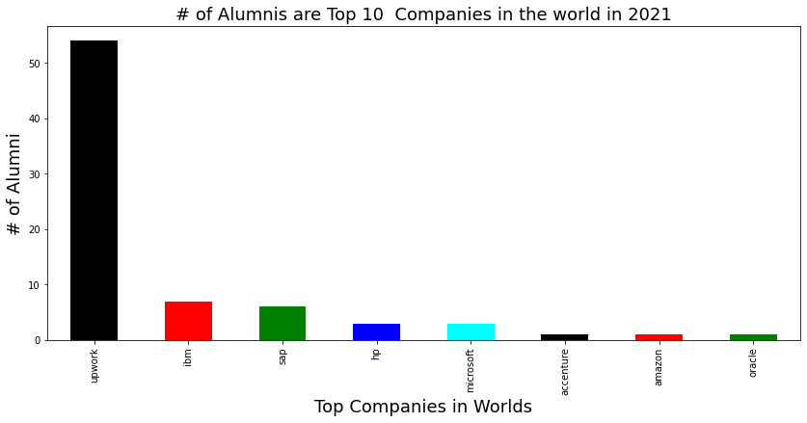
FAST Alumni in Top 10 Companies

Slide 13
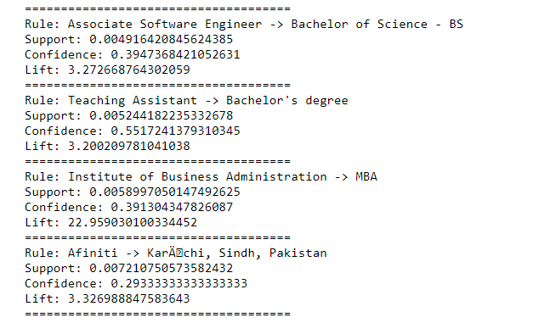
Machine Learning

Slide 14
Questions?

